Slide 1
DEVELOPMENT OF A BRAIN COMPUTER CONTROLLED HAND ORTHOSIS SYSTEM
A project by group-8 EEE401 students of Electronic and Electrical Engineering Department, Obafemi Awolowo University, 2019/2020 session.

Slide 2
PROBLEM STATEMENT
Humanity might become capable of regifting it’s dead elements with life . Certainly in this age of technology it should possess the ability to restore certain human vitalities. One of such vitalities is the ability of whole and non-partial movement of body parts. The following are major reasons why this study is very important:
Neuro-rehabilitation
Unpredictable period of recovery of physically disabled persons
Contributes to works on the revitalization of human motion
Contributes to works on prosthetics development
Aids physiotherapy
Pain reduction in movement e.g. rheumatoid patients

Slide 3
BACKGROUND INFORMATION
Neuron action potential: the brains computational unit. Communicates using chemicals called neurotransmitters. Has resting potential due to ion concentration gradient between it and its surroundings. Change in ion concentration gradient due to ion exchange represents flow of neurotransmitters(information) resulting in change in potential. Change in potential is called action potential(spikes). Firing rate(spikes frequency/timing) of neuron carries information on neuron activity

Slide 4
Cortical activity due to mass neuron action, EEG signals, cortical-homunculus: Invasive methods measure each neuron activity. Summation of closely located neurons activity(action potential) is present on the brain cortex(the surface of the brain) and can be measured using non-invasive methods. Measuring these group action potentials at the surface of the brain generate the EEG signals. Neurons in certain areas of the cortex are more active during certain brain and human activity, this is given by the cortical-homunculus also know as Dr. Penfield’s mapping of cortical activity.

Slide 5
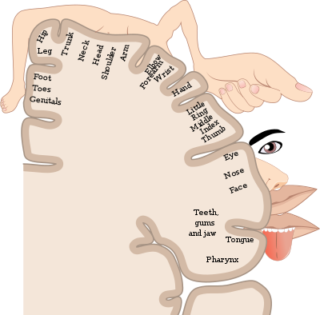
Δ (delta) | 0.5-4Hz | Deep sleep
Θ (theta) | 4-8Hz | Sleep
α (alpha) | 8-13Hz | Awake, slight activity
β (Beta) | 13-22Hz | Awake, full activity
ϒ (gamma) | 22-30Hz | Higher mental activity
cortical homunculus

Slide 6
Descending-pyramidal(Corticospinal) tracts of the Central Nervous System, sensorimotor / mu rhythm : Descending tracts are pathways by which motor signals are sent from the brain to lower motor neurons which innervate muscles to produce movement. The class of descending tracts of interest are the pyramidal-corticospinal tracts which are responsible for the voluntary control of the body.
Sensorimotor rhythm are oscillatory events in EEG signals originating from brain areas associated with preparation, control and carrying out of voluntary action. Such sensory motor rhythms are found in the alpha and beta frequency range commonly called mu-rhythm and β-rhythm respectively which occur during motor-actions

Slide 7
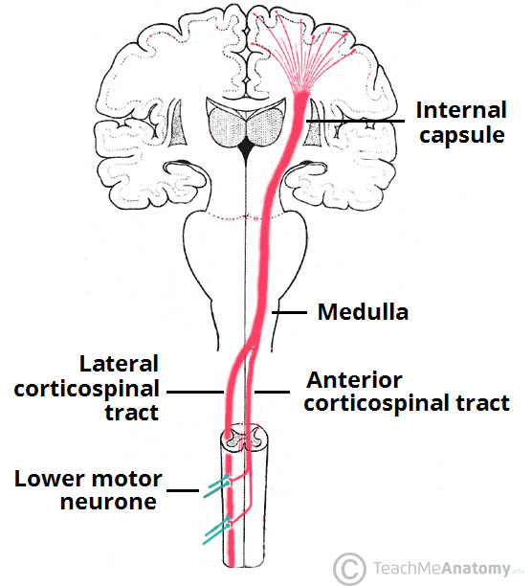
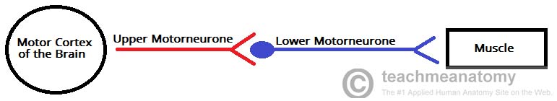
descending tracts

Slide 8
Motor-imagery : Motor imagery is a cognitive process in which a subject imagines that he or she performs a movement without actually performing the movement and without even tensing the muscles. Sensorimotor rhythm observed in motor-imagery is quite similar to that observed during the actual movement.
Useful sensorimotor rhythms for hand movement are found within the α and β EEG band
Motor imagery requires subjects(participants) not loosing focus and also not adapting to predictable sequence of motor-imagery task

Slide 9
10-20 electrode placement system: The 10-20 System of Electrode Placement is a method used to describe the location of scalp electrodes. These scalp electrodes are used to record the electroencephalogram (EEG) signals. Each electrode placement site has a letter to identify the lobe, or area of the brain it is reading from: pre-frontal (Fp), frontal (F), temporal (T), parietal (P), occipital (O), and central (C). The "10" and "20" refer to the fact that the actual distances between adjacent electrodes are either 10% or 20% of the total front–back or right–left distance of the skull

Slide 10
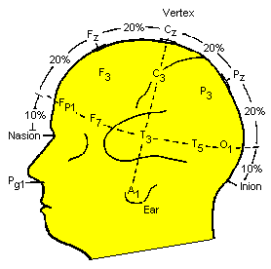
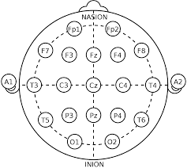

Slide 11
FUNCTIONAL BLOCK DIAGRAM
Signal Acquisition
Signal Processing
Feature Extraction
Neural state classification
Control of Hand Orthosis

Slide 12
PROBLEM SOLVING APPROACH
Preprocess data
Test feature-extraction method
Acquire and record EEG data
classification

Slide 13
SCOPE OF PROJECT AND DEVELOPED SOLUTION
Intended binary motor activity classification: grasp and release
Performance evaluation of methods and combination of methods
Four feature-extraction methods to be considered
No extensive study on instrumentation of hardware used

Slide 14
EEG SIGNAL ACQUISITION
Signal Acquisition is the process of sampling signals that measure real world physical conditions and converting the resulting samples into digital numeric values that can be manipulated by a computer.
Electroencephalogram(EEG) is an efficient modality which helps to acquire brain signals corresponding to various states from the scalp surface area.
Open-BCI is an open-source brain-computer interface platform. The boards can be used to measure and record electrical activity produced by the brain(EEG),muscles(EMG) and heart(EKG). EEG data acquired from OpenBCI hardware is to be displayed on the OpenBCI GUI. Data can be sent as streams to other BCI software using the Lab Streaming Layer

Slide 15
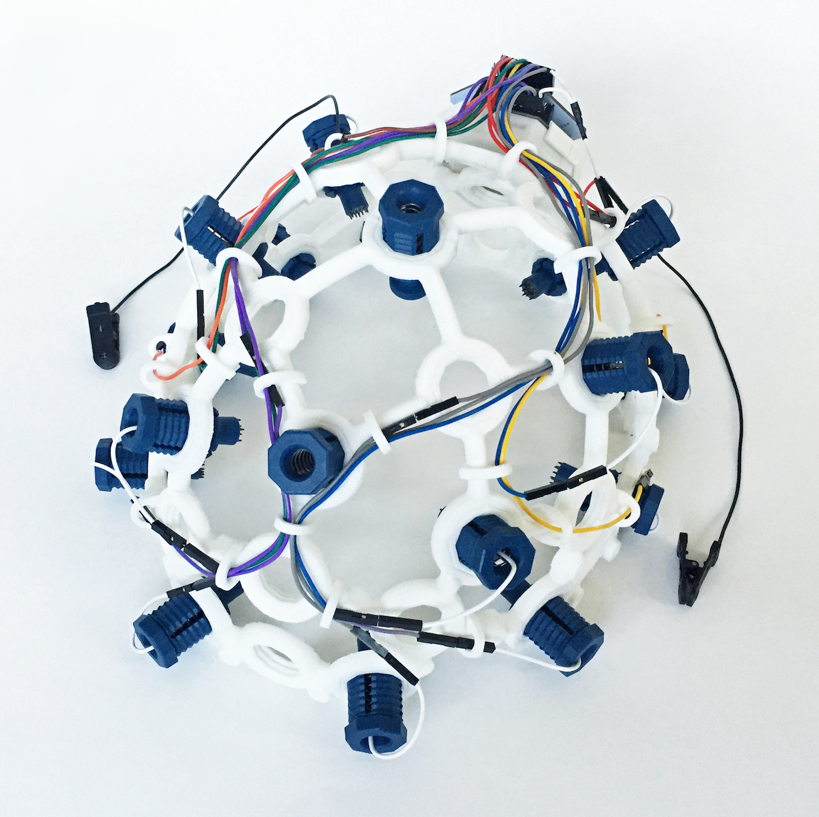
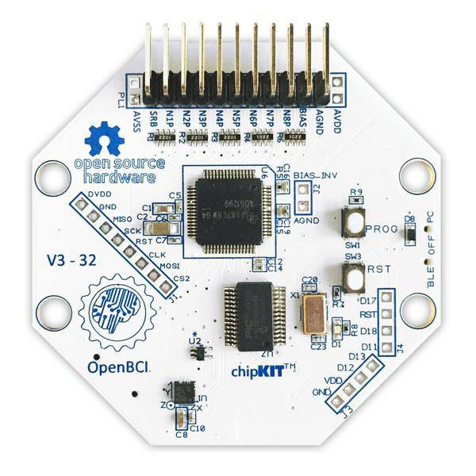
Hardware used | Software Used
Ultracortex-markIV headset | OpenBCI GUI
Cyton-board | Lab-Recoder
openBCI Bluetooth dongle | Lab Streaming Layer

Slide 16
Lab streaming layer (LSL) is a system for synchronizing streaming data for live analysis or recording. LSL is a good way to send your OpenBCI stream to applications that can record or manipulate the data, such as MATLAB and Python. LSL is part of the OpenBCI GUI. It was used from the interface directly instead of using Python or MATLAB.
Lab Recorder is the default recording program that comes with Neuropype and it works with LSL. It allows for recording of all streams on the lab network into a single file (XDF) with time synchronization. The lab recorder was used to get the streamed data from both the OpenBCI GUI and the Marker’s stream from under the Record from Stream workspace.

Slide 17
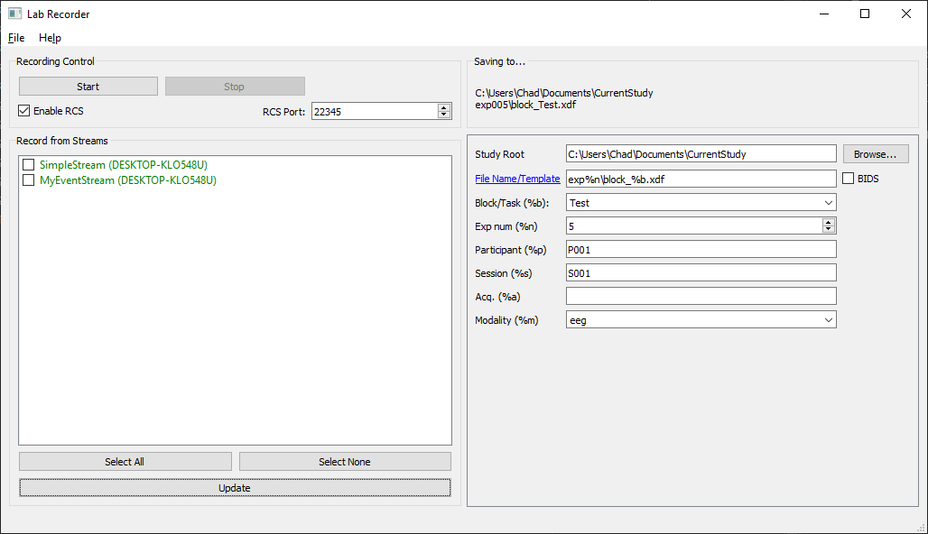
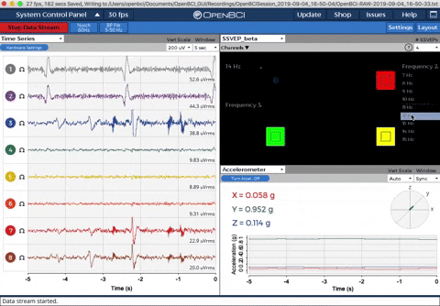

Slide 18
Ultracortex-markIV headset
Cyton board
BLE
OpenBCI- GUI (PC)
LSL
Lab-Recorder
Record XDF data
LSL
Lab-Recorder
Ultracortex-markIV headset
Cyton board
BLE
OpenBCI- GUI (PC)
LSL
Neuropype pipeline-designer
OSC
classifier
SERIAL
Hand orthosis
Controller

Slide 19
PREPROCESSING AND FEATURE-EXTRACTION
Raw EEG data acquired by non-invasive method is usually contaminated with biological and non-biological artifacts. Preprocessing involves removing these artifacts
To train classifier, we need to identify time window of certain events, for machine-learning classifier to learn from and classify events appropriately. Preprocessing helps identify unique events and their time of occurrence.
Certain parameters of EEG data which can indicate motor-imagery task being performed need to be computed from the EEG data. An understanding of the EEG data nature is needed to efficiently carry out this computations called feature-extraction

Slide 20
Pre-processing and feature-extraction were both software based, the software's used are, Neuropype pipeline-designer and python script.
implemented using the Two major preprocessing steps were carried out
FIR filtering (Band-pass): A band-pass filter with lower and upper cut-off frequencies of 8Hz and 30Hz respectively. Stop-band attenuation frequencies were 5Hz and 32Hz respectively.
Segmentation around events
Ocular | Below 4Hz
EEG | Below 1.2Hz
EMG | Below 30Hz
Power line interference | 50Hz

Slide 21
Four extraction methods were applied to the data whose resulting features were fed to a machine-classifier separately
Common Spatial Patterns (CSP)
Is a supervised technique for spatial filtering
used for maximization of discriminability of features
Common to binary motor-imagery classification applications
Output pattern pair vectors.
Finds spatial filters that maximize variance of filtered data from one class and minimize variance of filtered data from other class
Four spatial filters used in this project

Slide 22
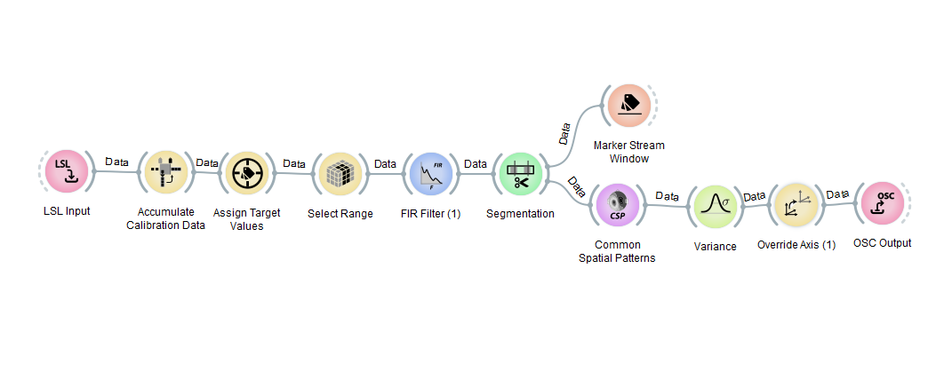

Slide 23
Filter Banks Common Spatial Patterns (FBCSP)
A modified form of CSP.
Based on the property of operational frequency band relating to efficiency of CSP
Splits EEG signals into frequency bands of interest using multiple band-pass filters and then performs CSP on each frequency bands separately
Signal split into the µ-band and β-band with frequency bands 8Hz to 12Hz and 13Hz to 30Hz respectively
Four spatial patterns used in this project

Slide 24
Principal Component Analysis (PCA)
Dimensionality reduction technique in spatial filtering
Improves runtime of classifiers
Removes correlations between component vectors of input data
Revels hidden dimensions of statistical variabilityy
Wavelet Transform
Time-frequency domain analysis method
A wave-like oscillation that is localized in time
Morlet wavelet used
Temporal and frequency resolution balance
Does not assume signals are stationary as opposed to Fourier analysis methods

Slide 25
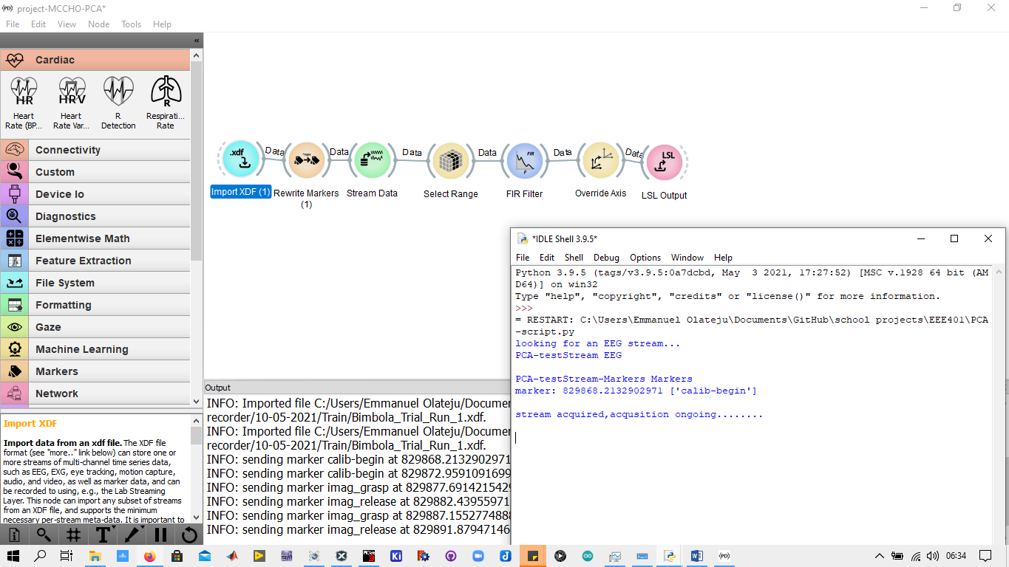

Slide 26
MACHINE LEARNING & CLASSIFICATION
Deep neural networks consisting of convolutional layers and LSTM layers are employed for classification of the CSP and FBCSP features.
Conventional Machine learning algorithms such as SVM, Linear Discriminant Analysis, Boosting algorithms are used to classify the PCA extracted feature vectors.
The CNN+LSTM classifier achieved an accuracy of 82% on training data and 59% on validation data after cross-validation on EEG data from multiple subjects.
The performance was limited by the insufficient amount of data available for training.

Slide 27
HAND ORTHOSIS DESIGN
Before printing the hand orthosis, thorough analysis was carried out on the human hand, to have an overview of what to design and picking the right measurement for each fingers. Autodesk Inventor(2021) was used to design the hand orthosis and the design was constructed into different sections and parts, it helps to ease the stress while using a 3-D printer to print the hand orthosis and its ease to assemble the parts together after printing. The design was constructed to be a left hand since majority of humans are right handed, so the left hand has limited functions it could perform, especially at old ages for humans, Although a right hand design can also be constructed for left hand users that find it difficult to use their right hand very well.
After the design has been completed using Autodesk Inventor (2021), the file is exported from Autodesk inventor(IPT File) to STL file, it was later sliced using Ultimaker Cura, which convert the STL file to the language the 3-D printer understands, that is Geometric code (G-code). The G-code is uploaded to the machine with the use of a memory card.

Slide 28
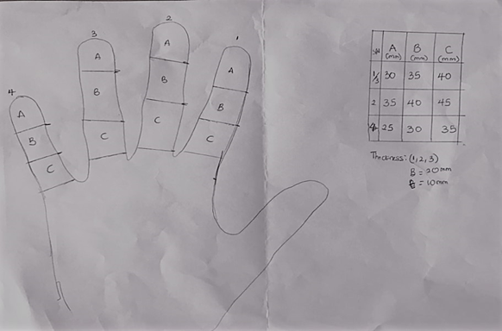
HAND ORTHOSIS DESIGN
THICKNESS: (1,2,3)
B = 20mm
W = 10mm
S/N | A (MM) | B (MM) | C (MM)
1&3 | 30 | 35 | 40
2 | 35 | 40 | 45
4 | 25 | 30 | 35

Slide 29
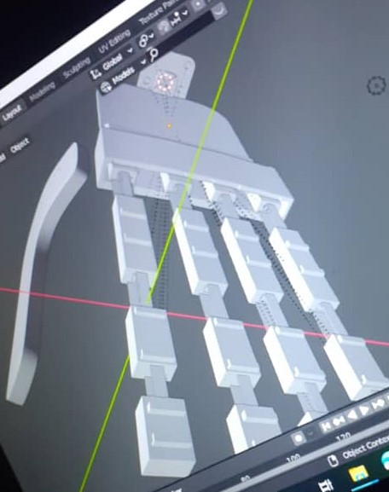
3D Design of the Hand Orthosis

Slide 30
THANK YOU FOR LISTENING

